Slide 1
Section 7:
Regression

Slide 2
Section 7 Overview
Regression equations
Correlation vs. Causation

Slide 3
Section 7 Overview
Regression equations
Correlation vs. Causation

Slide 4
Regressions
What does a regression of one variable on another variable tell us?
Why might we want to use regressions?
What is an example of when a regression might be useful?
What do regressions not tell us?
Notes:
Imagine you have a dataset that has income and health
Plot each data point
Draw a line go through the data
The regression line is that line

Slide 5
Regressions
What does a regression of one variable on another variable tell us?
  The “best fit” line between the two variables
Why might we want to use regressions?
  Determine whether there is an association between two variables. (When X moves, does Y also move in a consistent way?)
What is an example of when a regression might be useful?
  Example: How is life expectancy related to income?
What do regressions not tell us?
  Whether the relationship is causal, explanations for the relationship, etc.
Notes:
Imagine you have a dataset that has income and health
Plot each data point
Draw a line go through the data
The regression line is that line

Slide 6
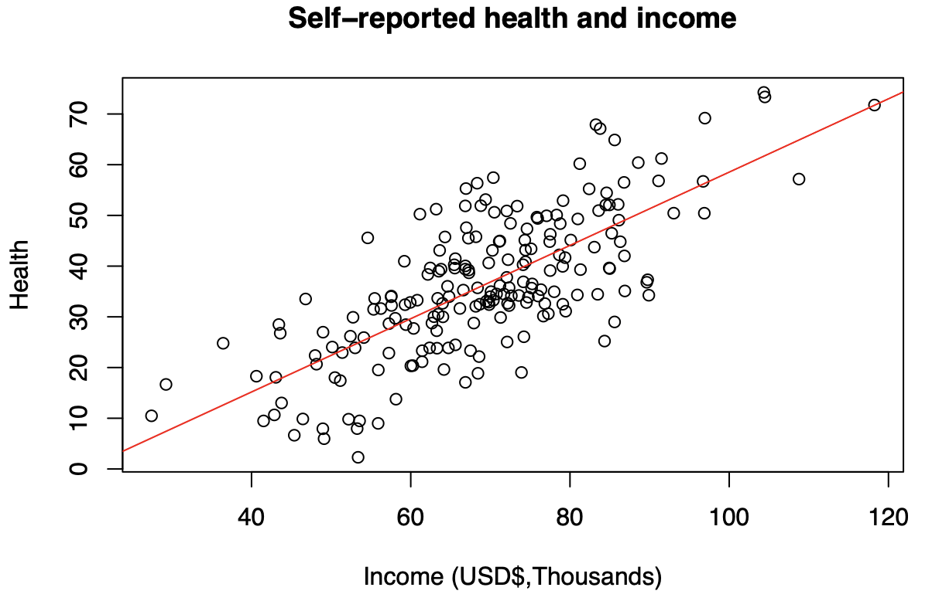
Health and Income
        How are these variables related? How strong is the relationship?
Notes:
We create a formula for this line -> if I make $60 what’s my expected level of health
-> But actual dots don’t fall exactly on this line, so what else could explain the relationship?

Slide 7
A Simple Linear (Bivariate) Regression
General form: Y = a + (b*X) + e
  a: y-intercept
  b: slope
  e: error
Why does this error term exist?
  We start with our data, then create a line of best fit (Statistics classes will explain how). Unless there is a perfect linear relationship between the two variables, there will be an error term. The error term is the gap between the person’s actual health and the line’s prediction, capturing a litany of other factors.
In the health vs. income relationship, what are some factors that could be in the error term?
  Anything that impacts health that isn’t perfectly explained by income: genetic conditions, differences in diet and exercise, etc.
Notes:
Bivariate means no controls

Slide 8
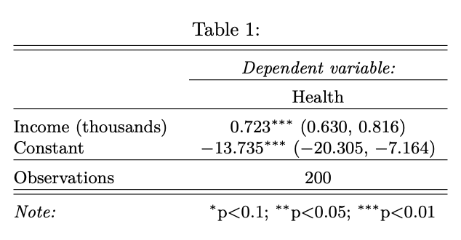
Bivariate Regression – Health vs. Income
What is the equation of the regression line?
  Health = – 13.735 + 0.723*(Income in 1000s)
How do we state the coefficient on income in words?
  A 1k increase in income is associated with a 0.723 increase in health points. This is a linear relationship
How do we know whether the relationship is statistically significant?
  Confidence intervals and p-values tells us whether slope is statistically significantly different from 0
  If 0 is included in the confidence interval, we can’t rule out that there is no relationship
  How would we interpret the slope if the confidence interval was (-0.4, 1.8)?
How could we predict the health of somebody of a given income? (e.g. $60K)
  Plug this income into the equation for the regression line, (at 60K income: 29.6 “health points”)

Slide 9
Adding Controls (Multivariable Regression)
General form: Y = a + (b1*X1) + (b2*X2) + … + e
  a: y-intercept
  b1, b2, …: slopes
  e: error
Why would we want to include other control variables in the model of health vs. income?
  Since there could be other variables that affect both income and health thus influence the relationship between the two
What other control variables may we want to add?
  Often called “confounders", Examples: parental income, age, place of residence, etc.
Notes:
Explain: imagine we’re looking at two people where everything else is the same but they have different incomes

Slide 10
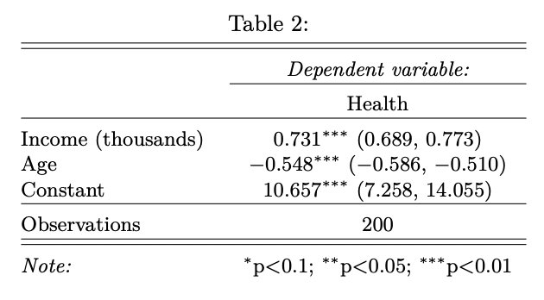
Multivariable Regression – Health vs. Income
We now add “age” as an additional control :
Does the sign of the coefficient on “age” make sense?
  Yes – as people age, their health declines
How do we interpret the coefficient on income?
  Holding age constant, a 1k increase in income is associated with a 0.731 point higher health score
Does the coefficient on income remain statistically significant?
  Yes – see p-value (asterisks)
Does the coefficient on income change? What does this mean?
  Not much, but you are the judge; this is not always objective

Slide 11
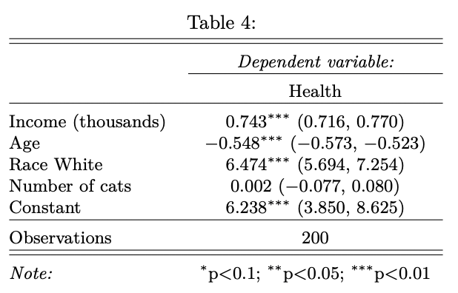
Should we just control for everything?
We now add “cats” as an additional control:
Does the size of the coefficient on “cats” make sense?
  Yes, because it is extremely small and is not significant (which makes sense, because we wouldn’t expect a relationship there!)
Does the coefficient on income remain statistically significant?
  Yes – see p-value (asterisks)
You, the discerning consumer of research, should determine whether what you are reading makes sense, given the regression specification! There is not always a clear-cut answer.

Slide 12
A follow-up example
A new (hypothetical) paper regresses “survival rate of craniotomy” on “size of teaching hospitals,” and finds that the larger teaching hospitals have worse survival rates. What can we conclude?
  We could conclude that larger hospitals are associated with worse outcomes
  OR we could suspect that our regression specification is incomplete
A reviewer tells the authors to control for underlying patient risk. The authors re-run the regression (with the new control), and find that larger teaching hospitals are now associated with better survival rates. What can we conclude?
  Sicker patients went to larger teaching hospitals in the first place. When controlling for disease state, the coefficient on hospital size flipped

Slide 13
Moving Toward Causality
Have we established a causal relationship between income and health?
  No!
What would we have to do to establish a causal relationship between income and health?
  Either (1) control for every variable that might influence both health and income [likely infeasible]
    In practice, no one will believe that you controlled for everything
  (2) Use experiment or a natural experiment
    Researcher recruits participants to assign treatment randomly

Slide 14
Direction of Causality
What if we were able to control for every variable that might influence both health and income?
  Again, this is probably completely infeasible.
In that case, would we know for sure that income causes an increase in health?
What if better health leads to higher income? Do our regression results tell us about which causes which?
  Can you come up with an explanation for why the relationship might run in this direction (from health → income)?
  Better health → More schooling or ability to work better jobs + Less time spent dealing with health issues → Higher income

Slide 15
Section 7 Overview
Regression equations
Correlation vs. Causation

Slide 16
Correlation vs. Causation
Reasons we may see a correlation, but it may not be causation:
  Third variable that explains/causes both (confounder)
  Random coincidence
  Reverse causality (causal relationship exists, but we got it backwards)

Slide 17
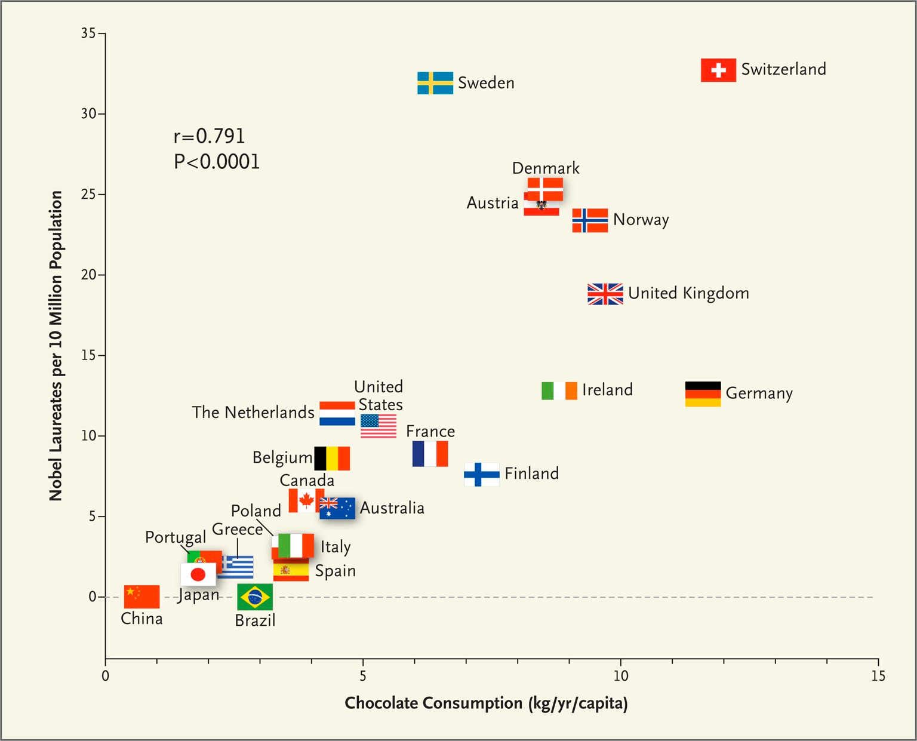
Correlation vs. Causation Examples
Notes:
What’s a third factor that could be causing both chocolate consumption and nobel laureates per 10 mil?
Ex: gdp per capita/ wealth/ economic development
Highlight the P Value here

Slide 18
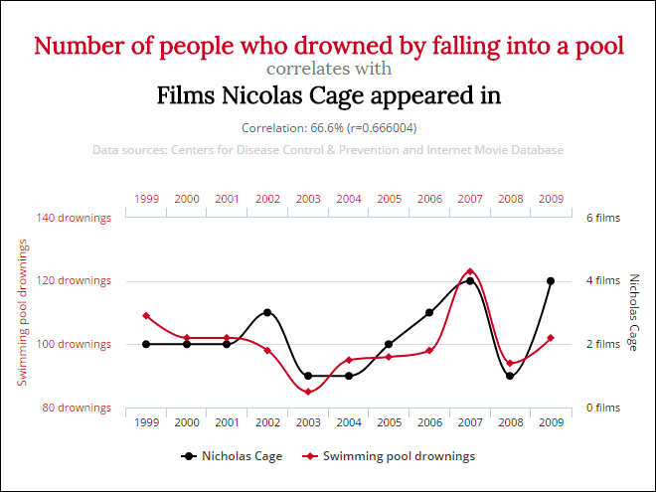
Correlation vs. Causation Examples
Notes:
This is an example of random coincidence or “spurious correlation”
Brainchild of Harvard Law School student Tyler Vigen, Spurious Correlations

Slide 19

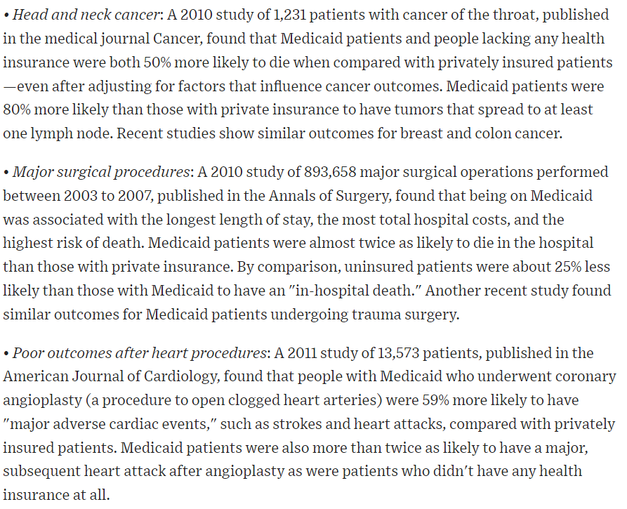
Correlation vs. Causation Examples
Evaluate this claim from an Op-Ed in the Wall Street Journal.
Basic gist of the papers the Op-Ed author cites:
  Patients w/ Medicaid were more likely to die / get sicker than privately insured (or uninsured in some cases)
  Many studies controlled for socioeconomic status

Slide 20
Correlation vs. Causation Examples
Are you convinced that Medicaid causes poor health or bad outcomes?
What are some factors (confounders) that might explain this relationship?
Notes:
Example answers: 1. No – could be reverse causality -> people enroll in Medicaid because they are sick; could be confounders
2. Example of a confounder is level of education

Slide 21
Correlation vs. Causation Examples
Are you convinced that Medicaid causes poor health or bad outcomes?
  No, there could be reverse causality (people enroll in Medicaid because they are sick) and omitted variable bias
What are some factors (confounders) that might explain this relationship?
  Socioeconomic status, educational attainment, pre-existing health conditions, health behaviors, cultural background, etc.
Notes:
Socioeconomic Status: Individuals who qualify for Medicaid may have lower incomes and less access to resources, which can be associated with poorer health outcomes.
Educational attainment: Higher education levels are associated with better health outcomes, so differences in educational attainment can be a confounding factor.
Pre-existing Health Conditions: People who enroll in Medicaid may already have underlying health conditions that contribute to their poor health outcomes.
Health Behaviors: Differences in health-related behaviors such as diet, exercise, smoking, and alcohol consumption can impact health outcomes.

Slide 22
Questions?

